Slide 1


The world COVID-19 pandemic report in 2020
Author: Langyu Qie
Date: November 16th

Slide 2

Background
The COVID-19 pandemic, also known as the coronavirus pandemic, is an ongoing pandemic of coronavirus disease 2019 (COVID-19) caused by severe acute respiratory syndrome coronavirus 2 (SARS-CoV-2), first identified in December 2019 in Wuhan, China. The World Health Organization declared the outbreak a Public Health Emergency of International Concern in January 2020 and a pandemic in March 2020. As of November 15th, 2020, more than 53.9 million cases have been confirmed, with more than 1.31 million deaths attributed to COVID-19.

Slide 3
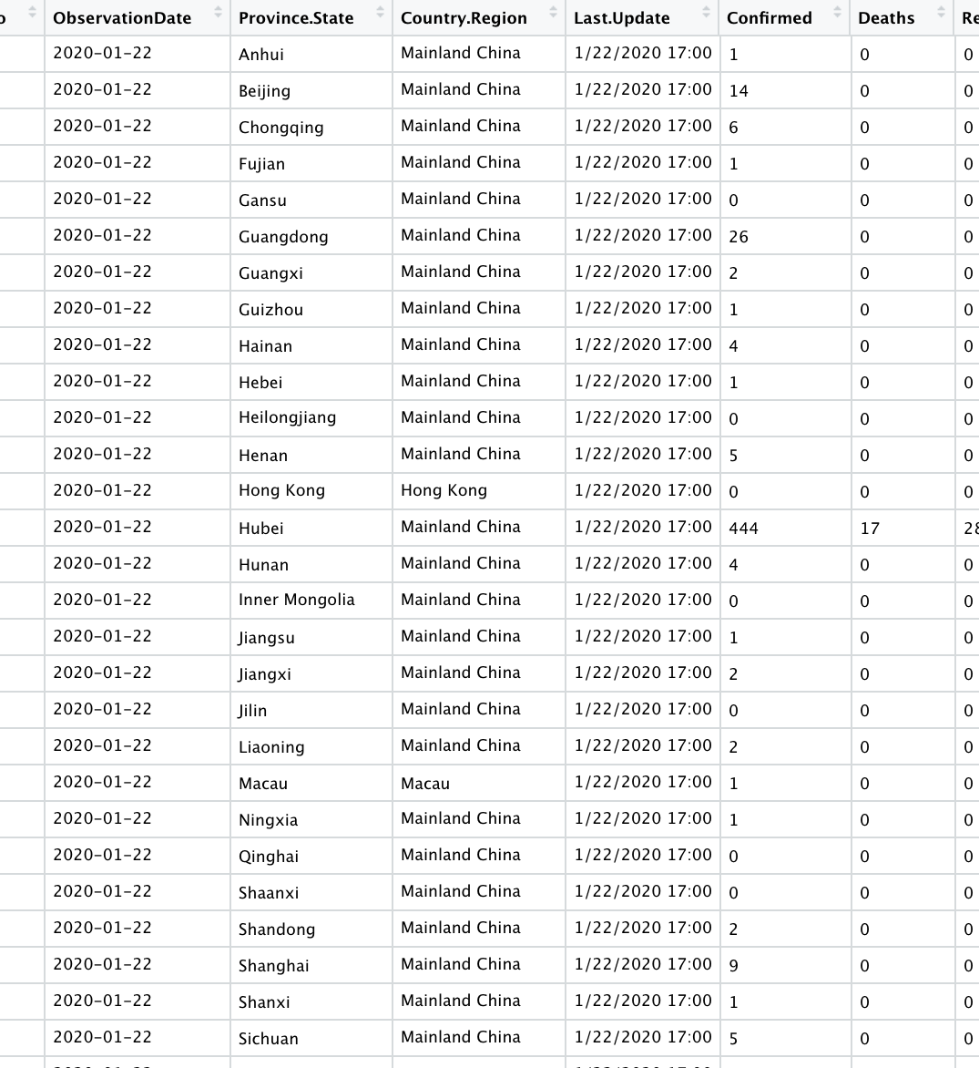
Origin
Source of data set:
https://www.kaggle.com/sudalairajkumar/novel-corona-virus-2019-dataset?select=covid_19_data.csv
This data set contains 116,806 observations, it counts the number of the confirmed cases, deaths, and recovered cases from January 22nd to September 23rd in every provinces in every countries in the world.

Slide 4

China

Slide 5
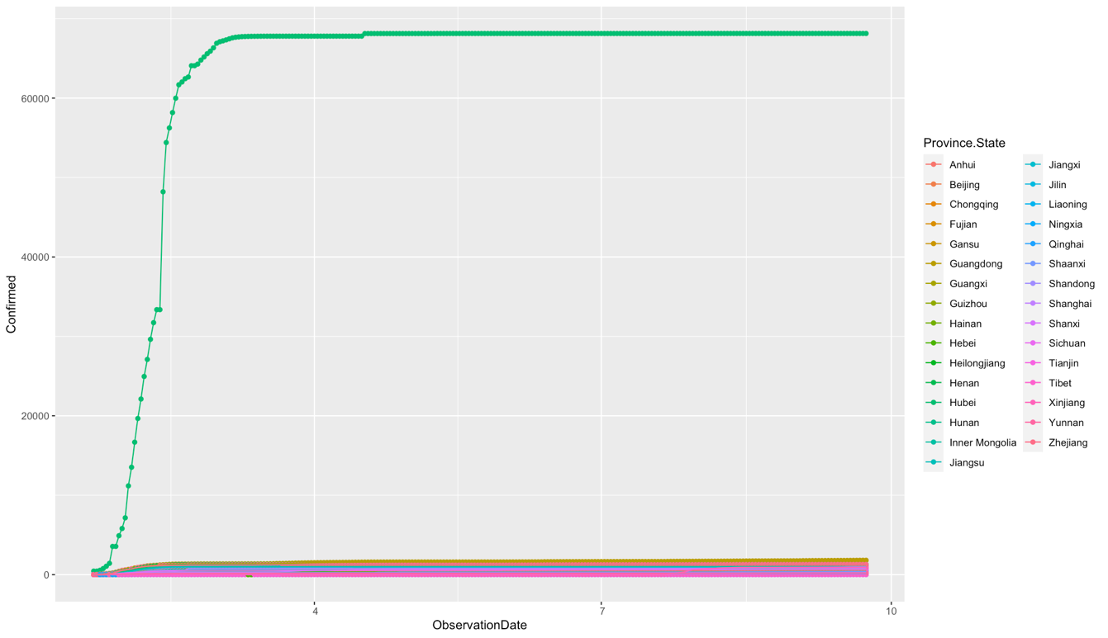

Confirmed cases
The line of Hubei province really stands out. The number has a sharp rise in February, and it kept increased to nearly 70,000. The number of confirmed cases in Hubei remained relatively stable from March to September, and it has been under 70,000 the whole time.

Slide 6
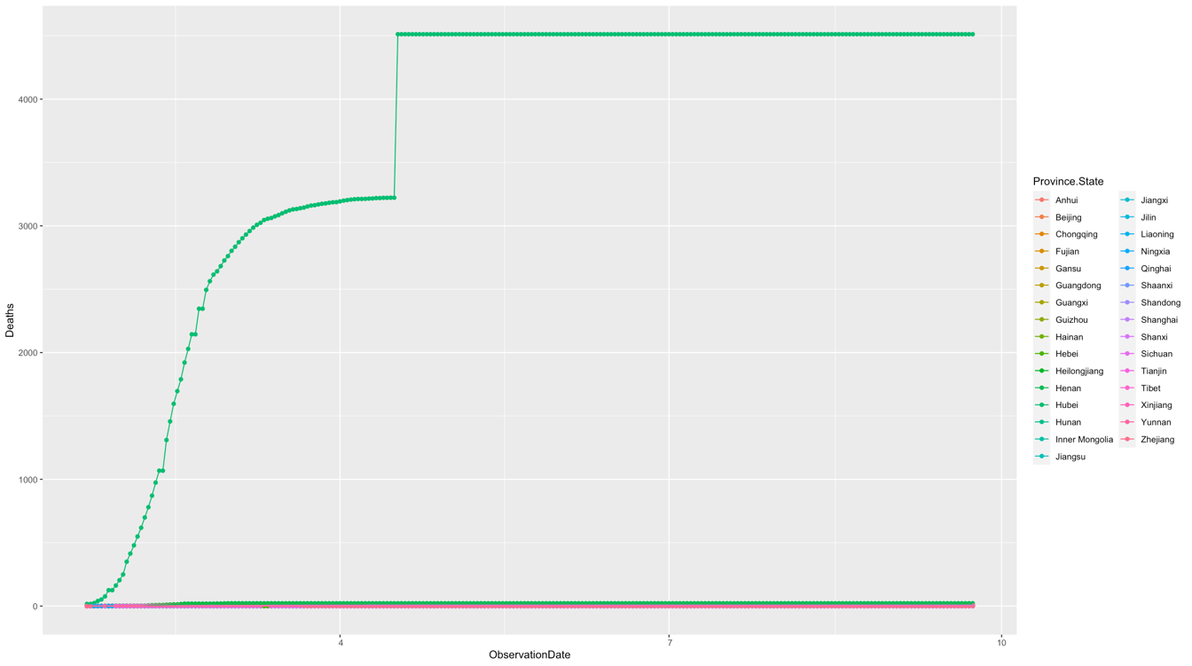
Deaths
Number of deaths in provinces other than Hubei are trivial. The number of deaths in Hubei has been increasing since January, and it has gone beyond 3,000 in March. There is a jump of the number in April, and it went to approximately 4,500 from less than 3,300 all of a sudden. It stays at this number from then till September.

Slide 7
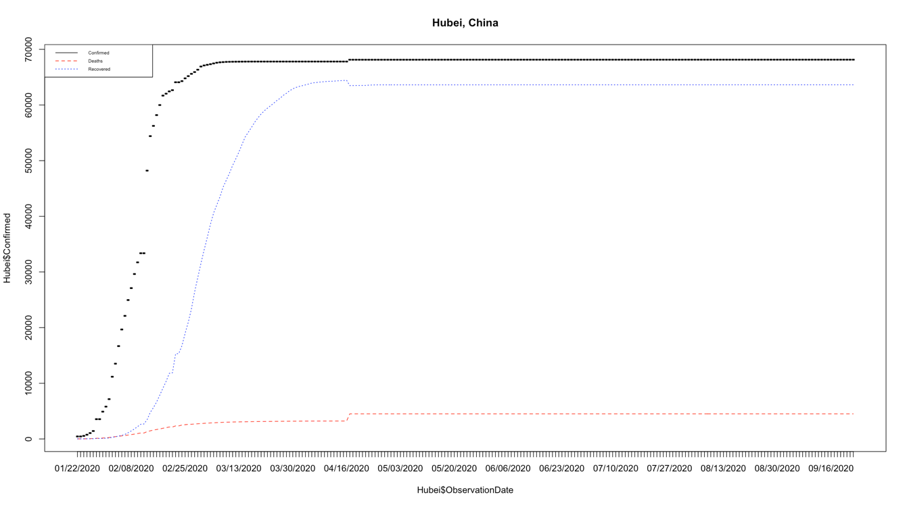
HUBEI
Most of the patients have recovered from COVID-19 in September.
The confirmed cases aren’t increasing from May to September.

Slide 8
Italy

Slide 9
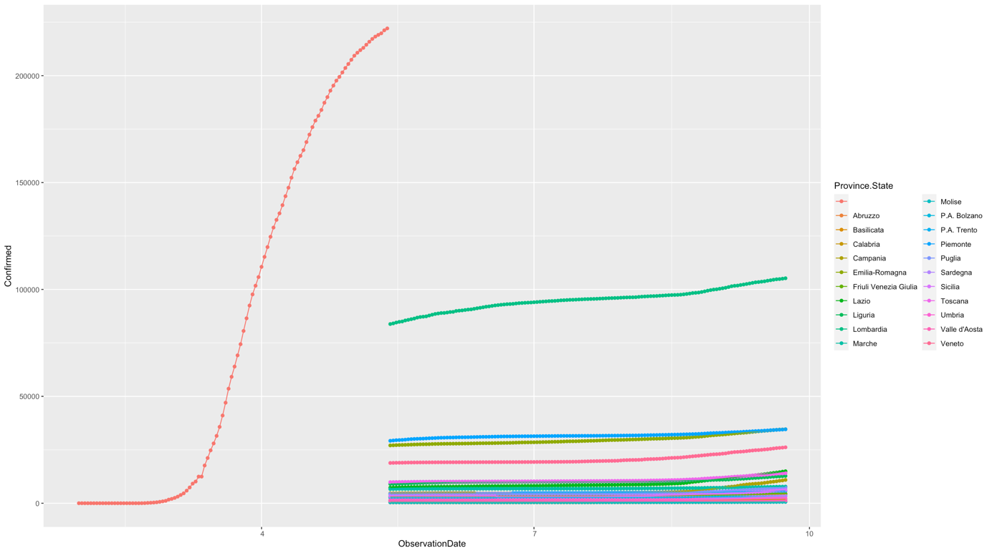
Confirmed Cases
The number of confirmed cases kept climbing since February. It has increased to around 225,000 in May.
among all the provinces, Lombardia has the largest number of confirmed cases, around 100,000.
Other provinces all have confirmed cases under 50,000.

Slide 10
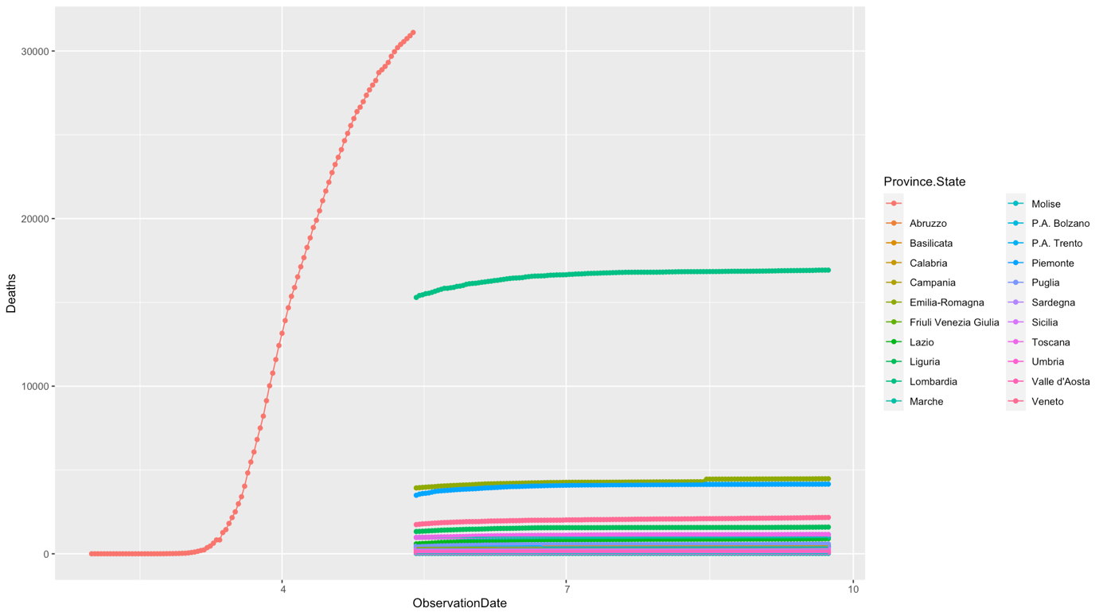
deaths
Number of deaths had been increasing since March, and it has reached 30,000 in May.
Among all the provinces, Lombardia has the highest number of deaths

Slide 11
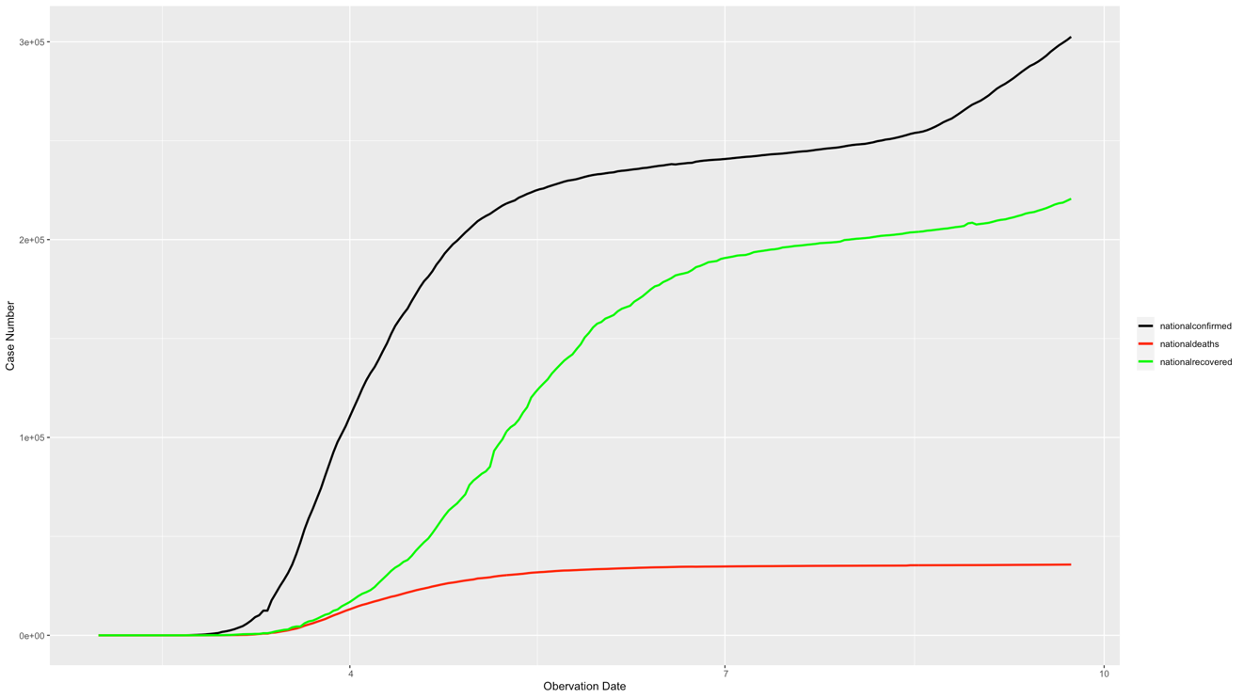
Time series case count in Italy
confirmed cases has been growing faster than recovered cases in most of the time
Growing rate of confirmed cases become slower in June and July for a short time.
Number of confirmed cases has reached 300,000 in September.
Number of deaths has reached 35,000 in September

Slide 12
US

Slide 13
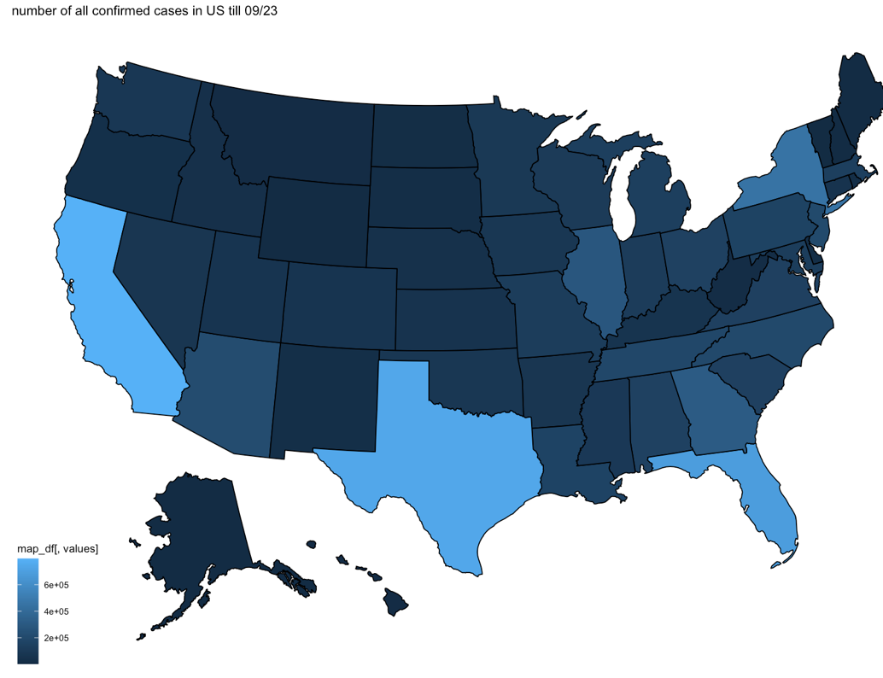
Confirmed cases across US till 09/23/2020
California took the worst hit, nearly 800,000 confirmed till 09/23/2020
Taxes, Florida and New York also have confirmed cases more than 400,000 till 09/23/2020

Slide 14
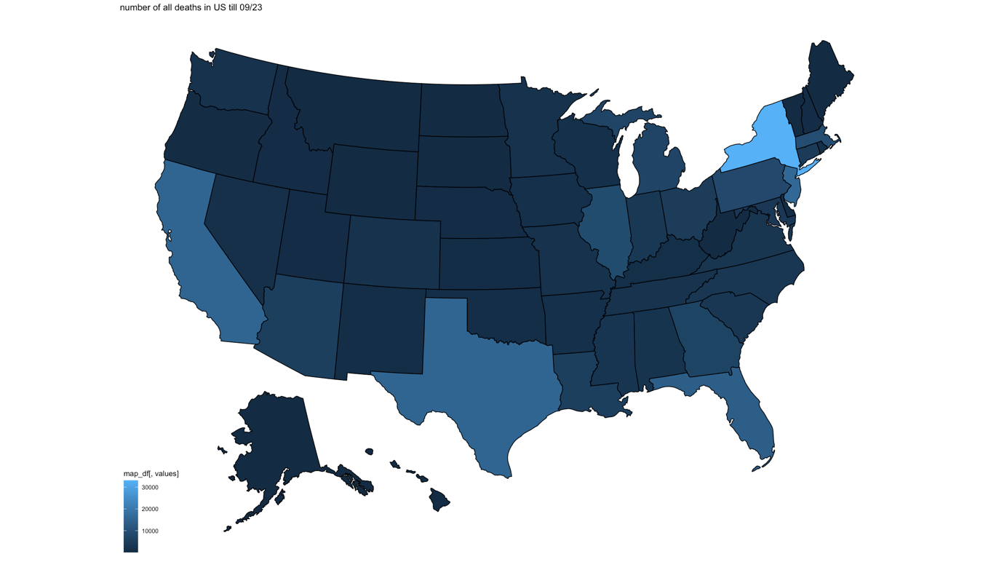
Deaths across us till 09/23/2020
New York had the highest number of deaths, more than 30,000 deaths over 8 months.
California, Texas, Florida have deaths over 10,000

Slide 15
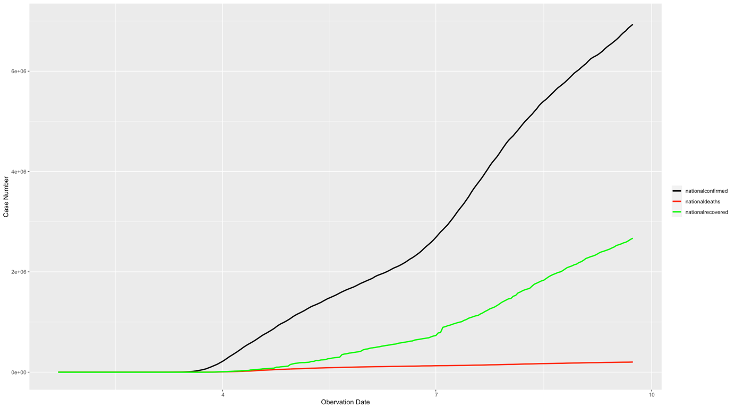
Time series case count in us
the number of confirmed cases has been increasing from May to September, however, the increasing rate didn’t change too much. The rate appears to go a little slower in June, but it went right back up in July.
the number of recovered doesn’t seem optimistic when we compare it to the number of confirmed cases. When it came to September, the number of recovered cases across US has not reach half of the number of confirmed cases

Slide 16
Cases around world

Slide 17
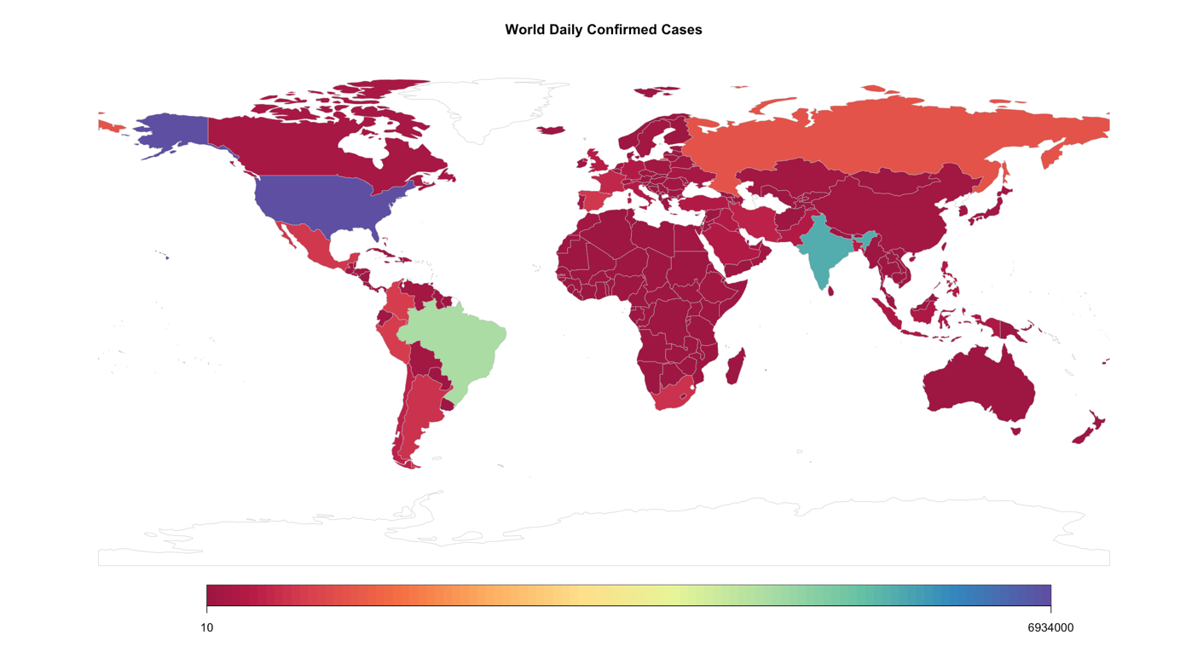
World confirmed cases 01/22–09/23
US has the most confirmed cases among all the countries in the world, which is nearly 7 million cases.
India has over 5 million cases.
Brazil has over 4 million cases.

Slide 18
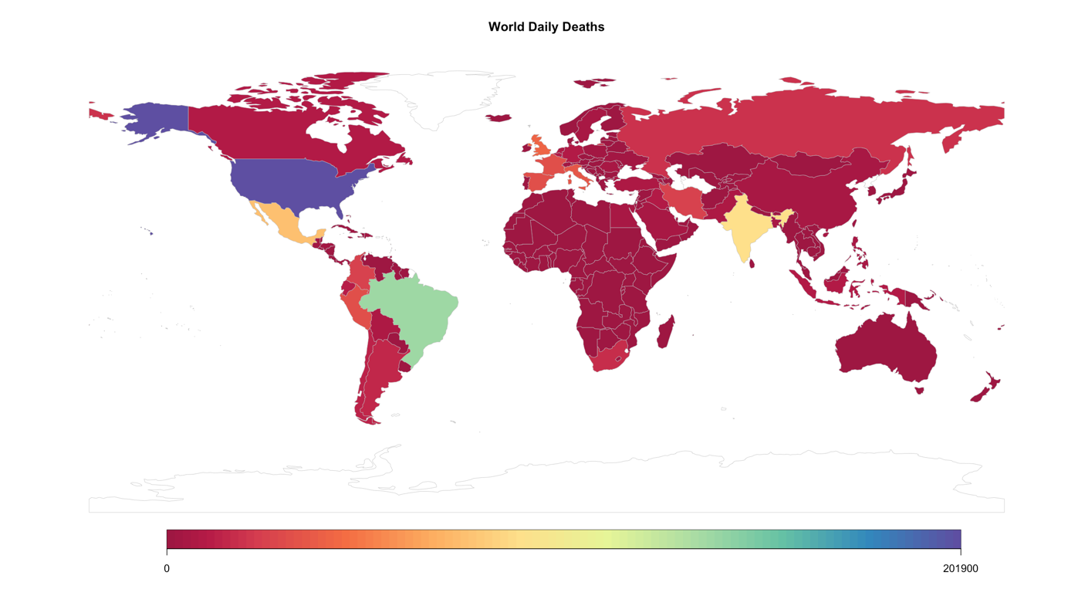
World deaths 01/22–09/23
US has over 200,000 deaths
Brazil has over 130,000 deaths
India has over 90,000 deaths
Mexico has over 70,000 deaths

Slide 19
CFR of covid-19

Slide 20

What is CFR?
CFR, i.e. case fatality rate is defined as: $CFR=\frac{number of deaths from the disease}{number of diagnosed cases of the disease}$
It can be considered as the risk of dying from a certain disease. Now CFR of COVID-19 has been a primary concern for the public.
Limitations:
From the definition of CFR, we know that CFR is not a constant. It changes with time and locations. However, we are not going to show how CFR changes by day due to the errors in measurements and low quantities in sample in the first half of year. Instead, we are going to choose two days in the second half of year and calculate the CFR in each country in those two days.
Notes: With acknowledgement of these severe limitations, we continue to use `deaths/confirmed` as a very rough proxy of CFR

Slide 21
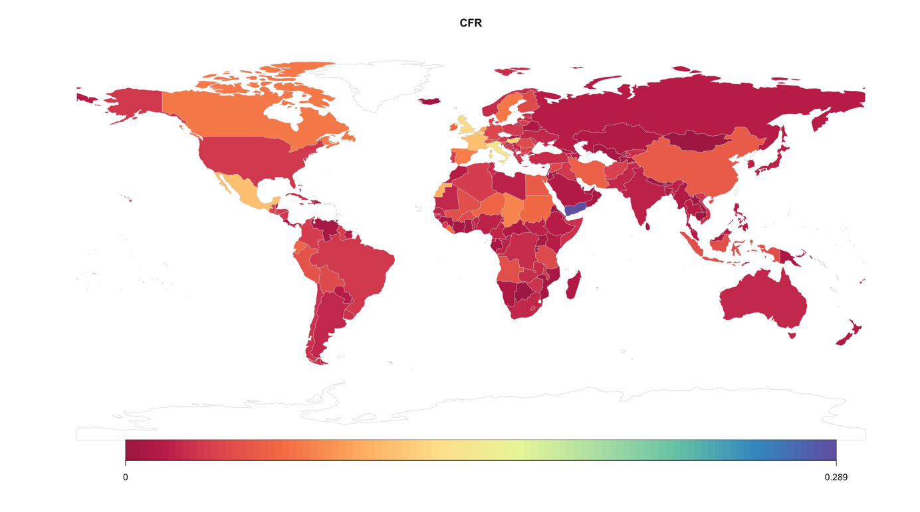
CFR on 08/23/2020

Slide 22
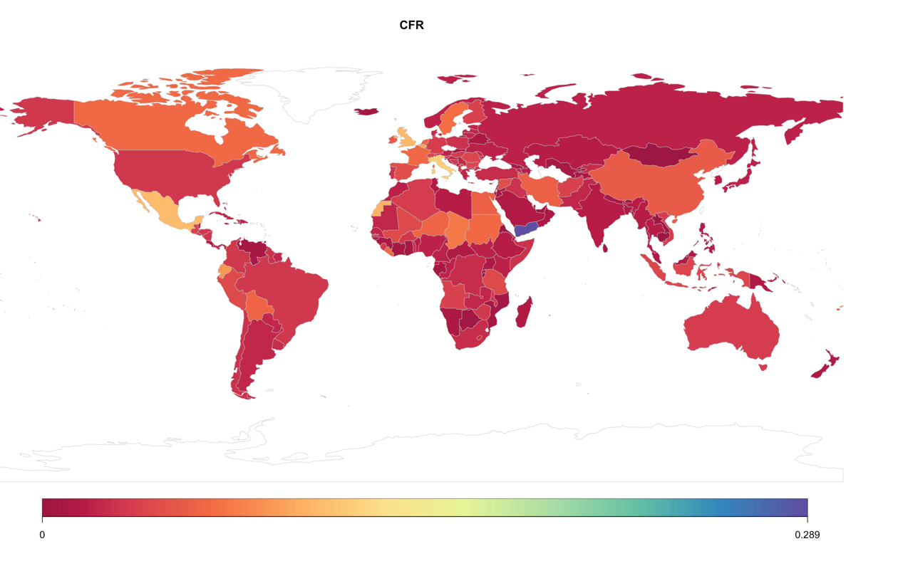
CFR on 09/23/2020

Slide 23
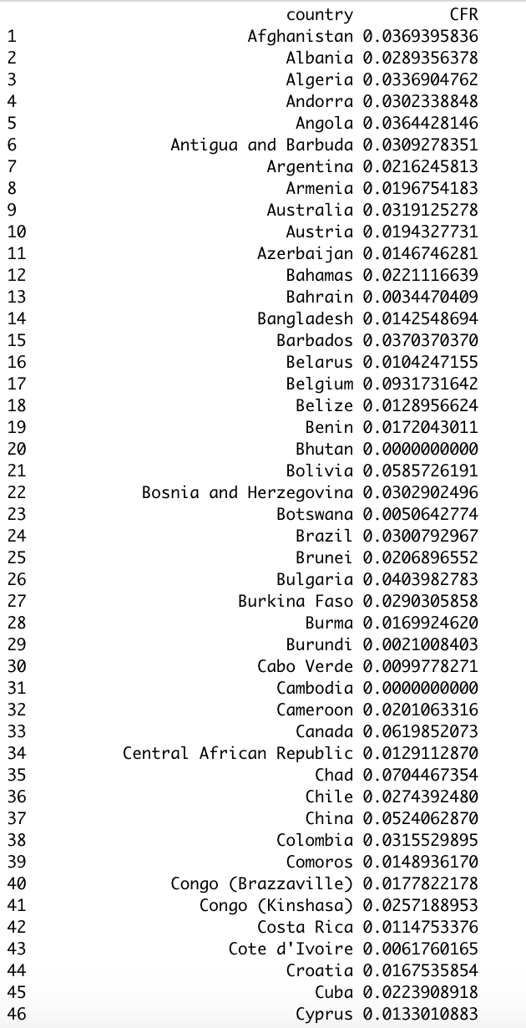
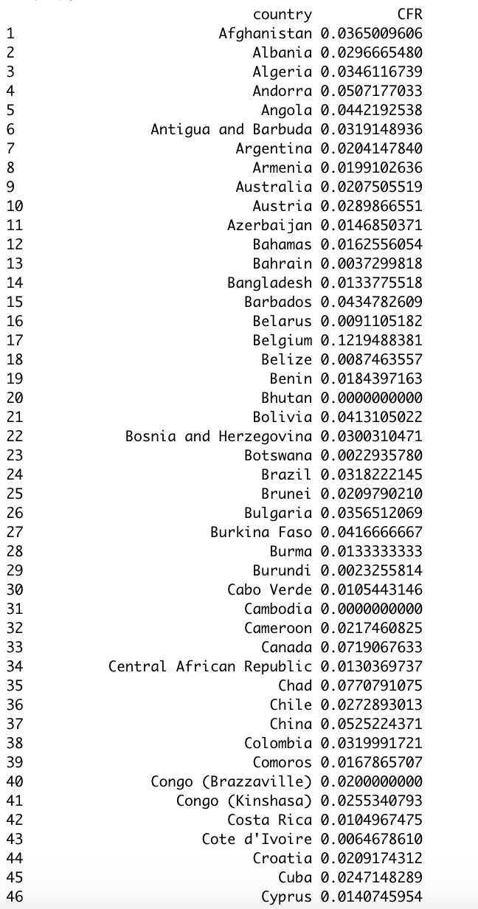

Slide 24
conclusion
From comparison of two maps above, we found that there are no prominent distinctions between two maps. This suggests that CFR in each country has become stable in the last two months. Also, From the color palette we see that only a few countries, for example, Yemen, have CFR that’s conspicuously higher than other countries in the world. Of course, CFR is also affected by factors like age, diabetes, obesity and so on. Differences in proportion of these factors in different areas also lead to regional disparity.
Although there are countries having CFR extremely low, we can’t lower our guard for the risk of dying from COVID-19. In most countries, 2%~3% confirmed cases of COVID-19 are dead.

Slide 25


Thanks for watching

